Slide 1
DeepAlign, a 3D alignment method based on
regionalized deep learning for Cryo-EM
A. Jiménez-Moreno , D. Střelák, J. Filipovič , J.M. Carazo, C.O.S. Sorzano
https://doi.org/10.1016/j.jsb.2021.107712

Slide 2
Goal For 3D Alignment
Find orientation and position parameters in 3D sphere.
Low SNR leads to low accuracy easily
Trapped at local minima easily
Notes:
In-plane rotation 、shift translation

Slide 3
Deep Align
Angular space
Divide into several regions
Why need to divide ?
Experimental image
By CNN
Classify to region
Alignment

Slide 4
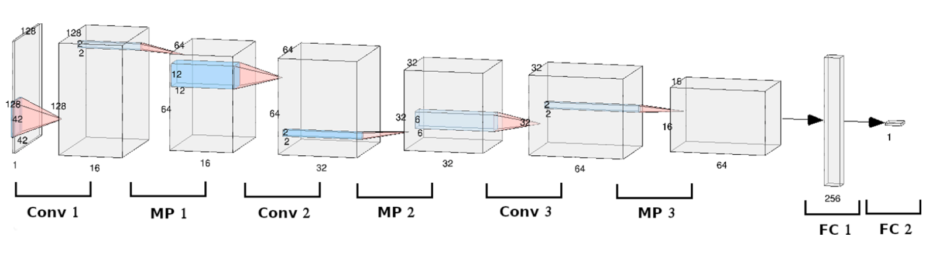
CNN
Dropout layer
Dropout layer
Dropout layer

Slide 5
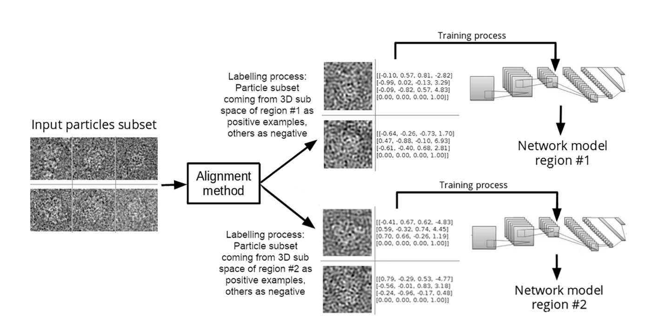
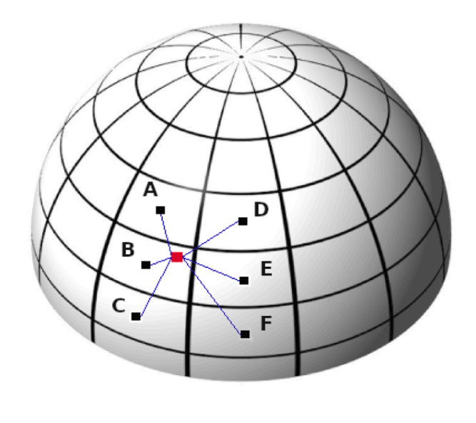
Training Process

Slide 6
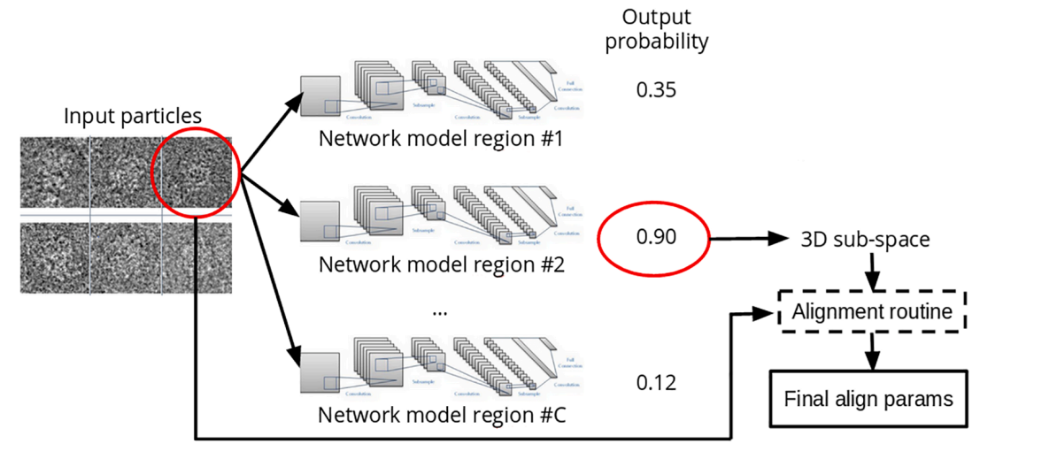
Prediction Process

Slide 7
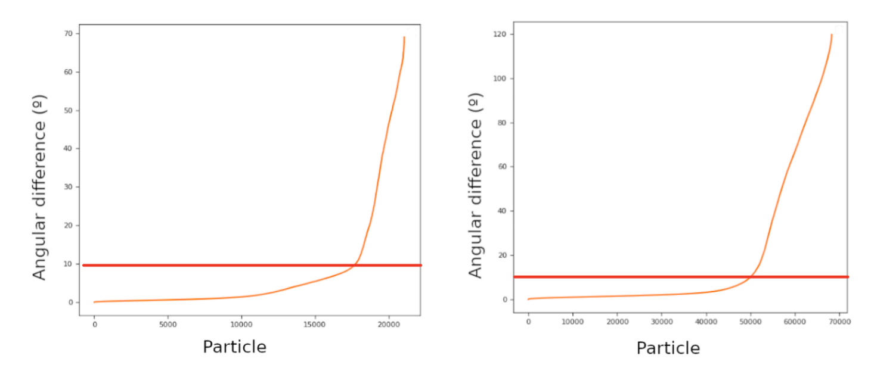
Consensus tool
proteasome
ribosome
Xmipp Highres vs Relion
DeepAlign vs Relion

Slide 8
Result

Slide 9
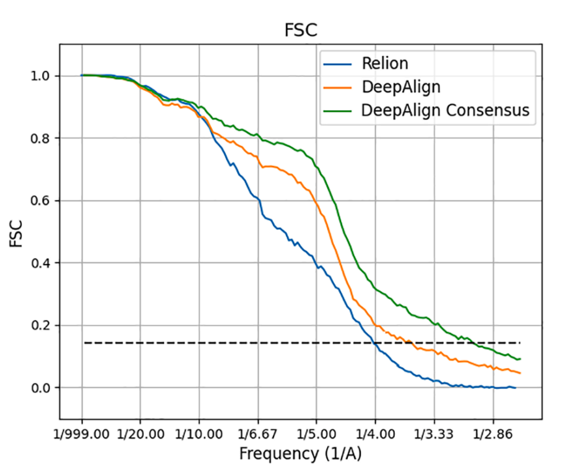
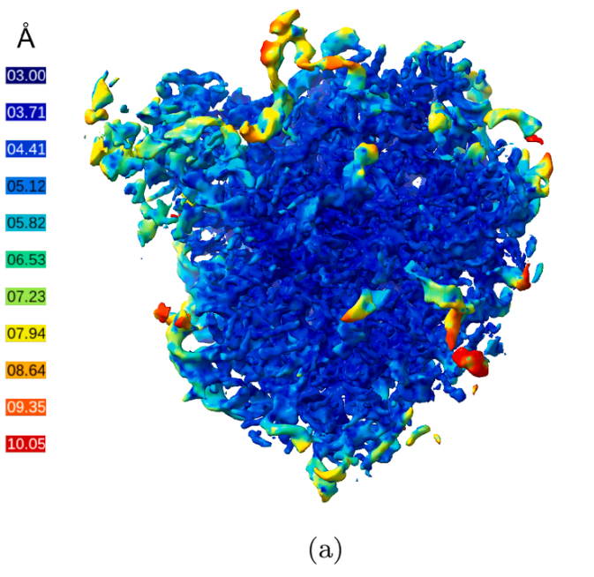
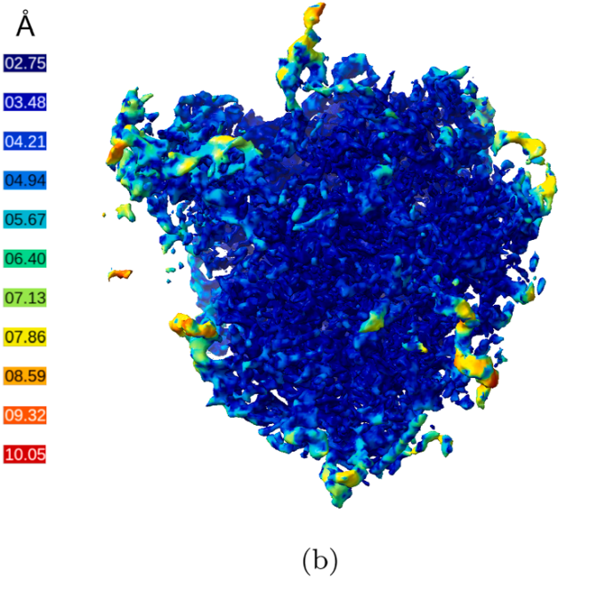
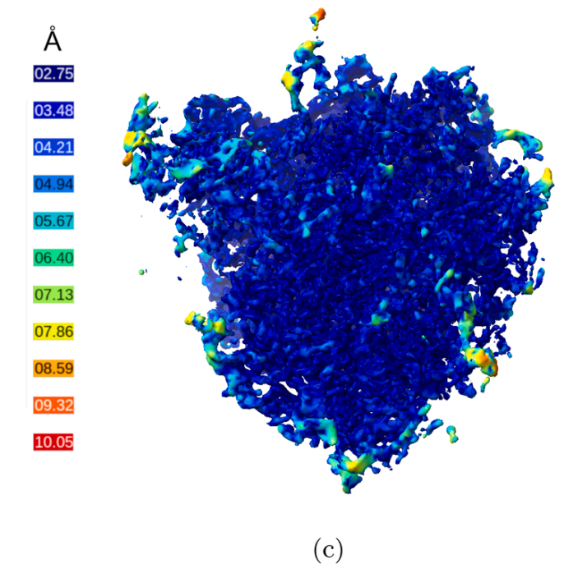
Ribosome
(4.0 Å)
(3.5 Å)
(2.9 Å)
Relion
Deep Align
Deep Align
Consensus

Slide 10
Ribosome
DeepAlign
consensus
Relion
DeepAlign
Time
2 days
1.5 hrs
Resolution
3.3Å
2.9Å
2.7Å
Note
Discarding imges
from 85,012 to 57,880

Slide 11
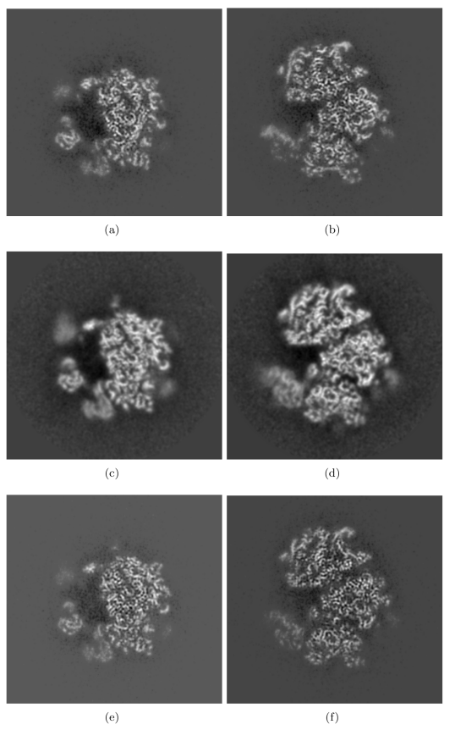
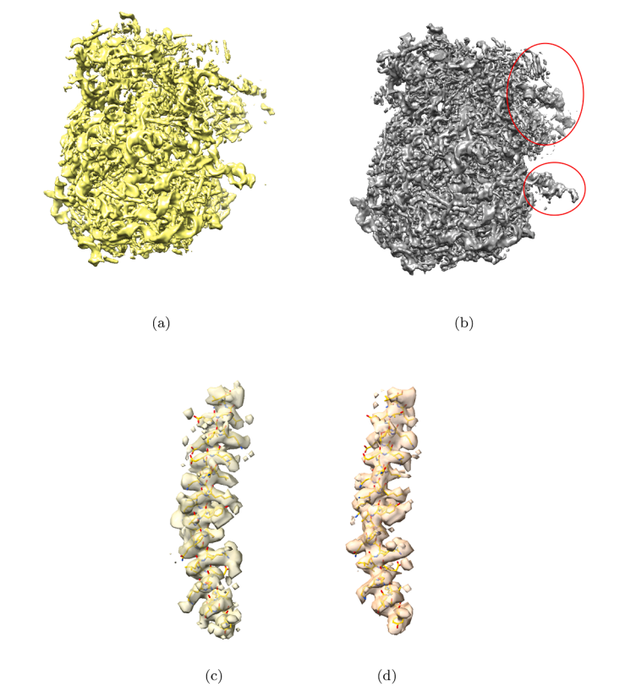
Ribosome
Relion
Deep Align
Deep Align
Relion
Deep Align
Consensus
Z-axis
Y-axis

Slide 12
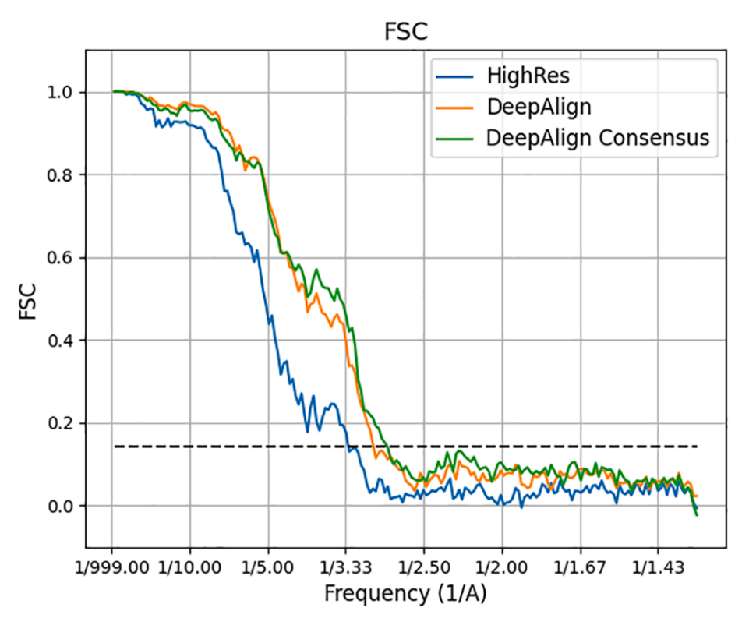
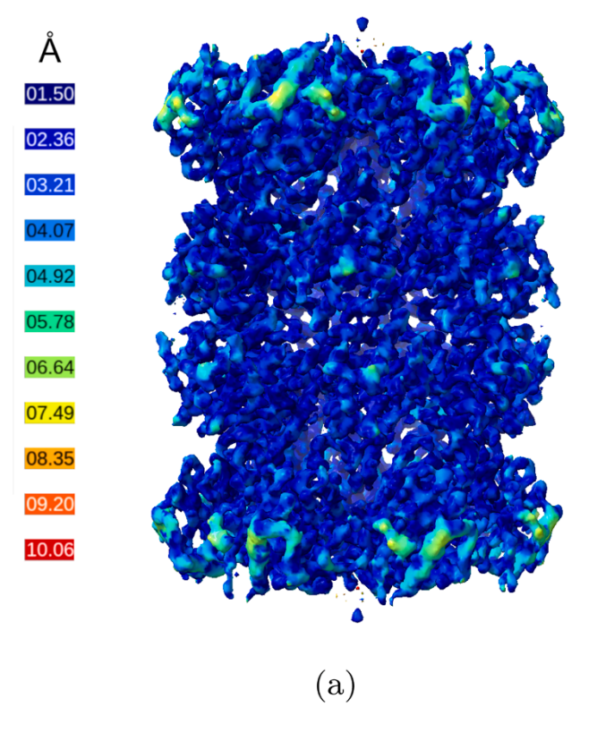
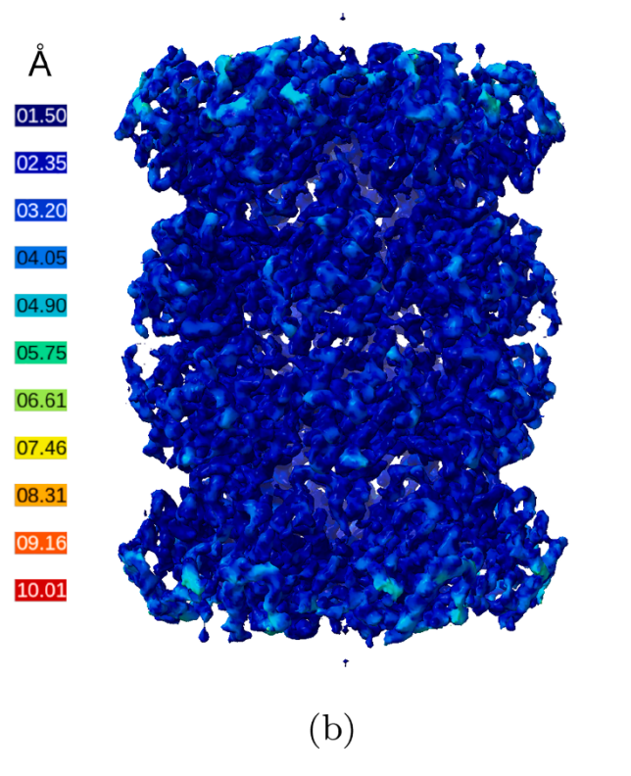
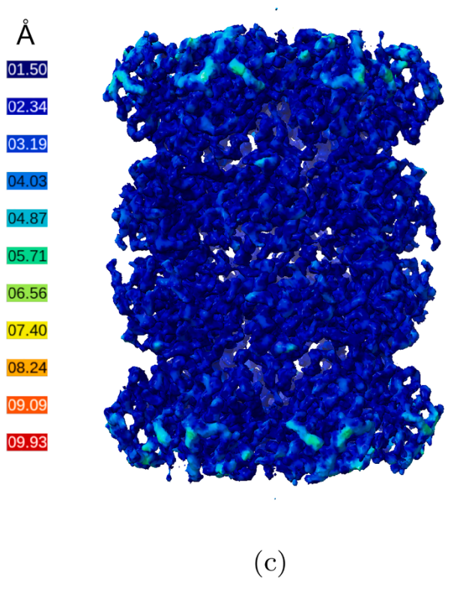
T20S proteasome
(3.3 Å)
(2.9 Å)
(2.7 Å)
HighRes
Deep Align
Deep Align
Consensus

Slide 13
T20S proteasome
Xmipp Highres
DeepAlign
consensus
DeepAlign
9 hrs
Time
20 hrs
20 hrs
3.8Å
Resolution
4.0Å
3.5Å
3.5Å
Note
One more DeepAlign
Discarding imges
from 26,230 to 19,086
procedure

Slide 14
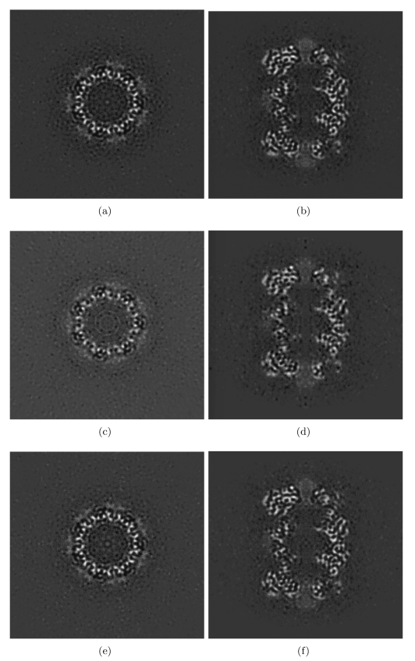
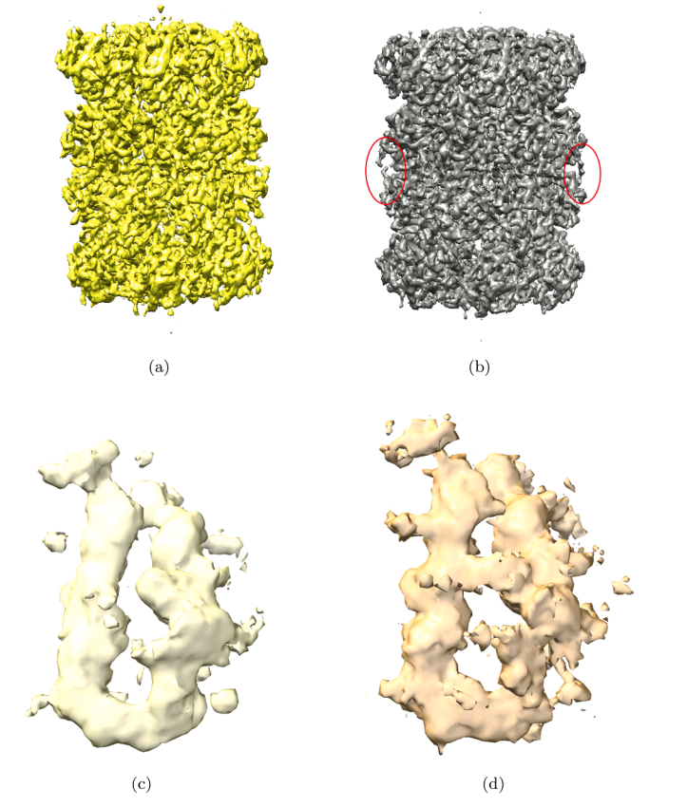
T20S proteasome
HighRes
Deep Align
Deep Align
HighRes
Deep Align
Consensus
Z-axis
Y-axis

Slide 15
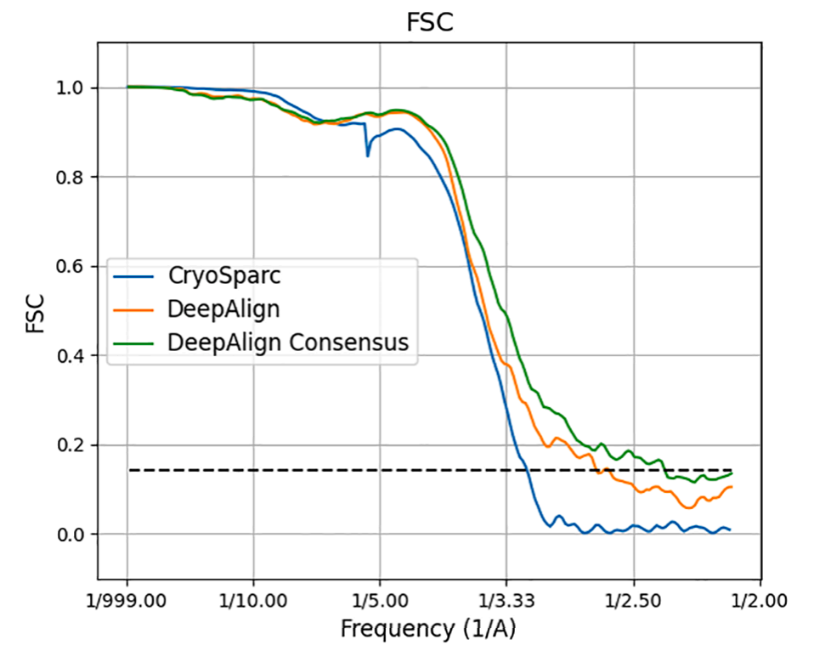
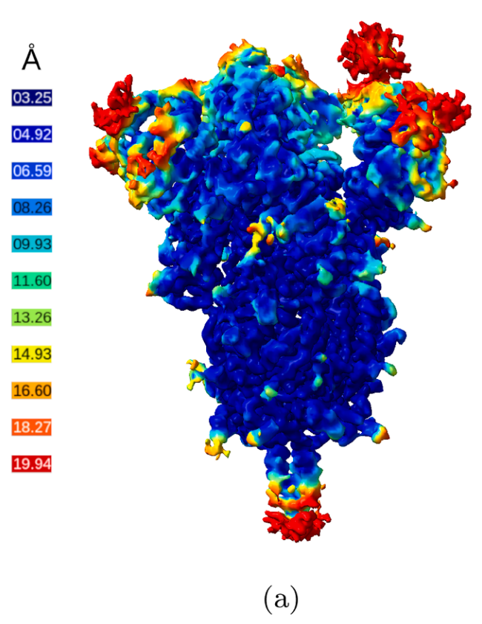
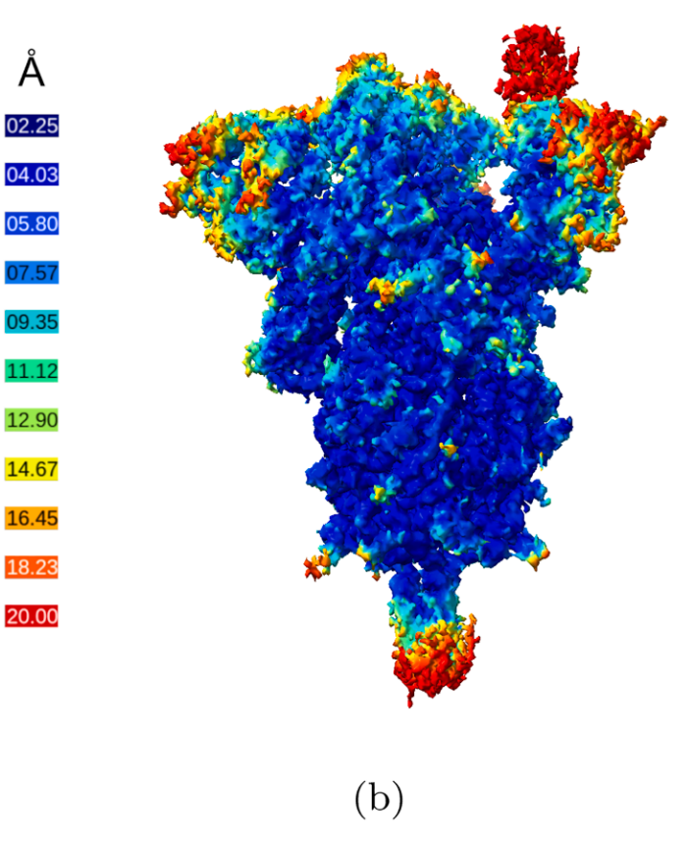
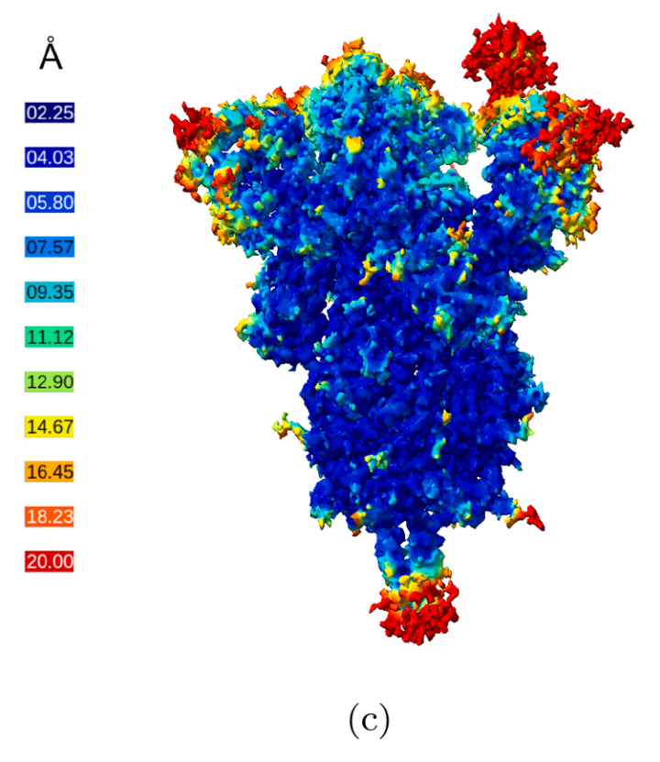
SARS-COV-2 Spike
(3.1 Å)
(2.7 Å)
(2.4 Å)
CryoSparc
Deep Align
Deep Align
Consensus

Slide 16
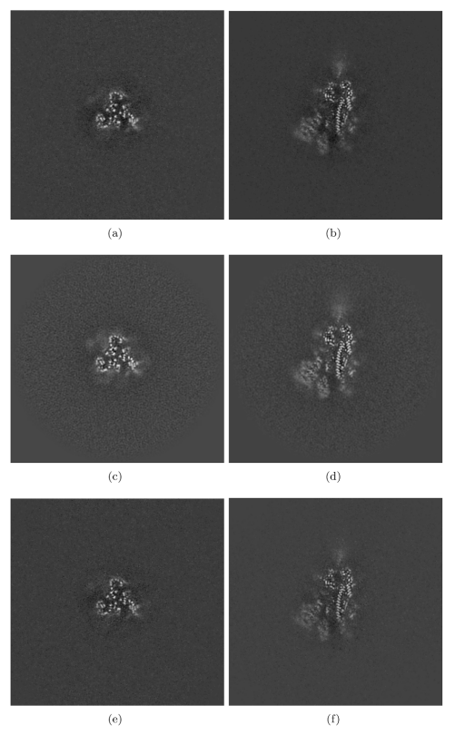
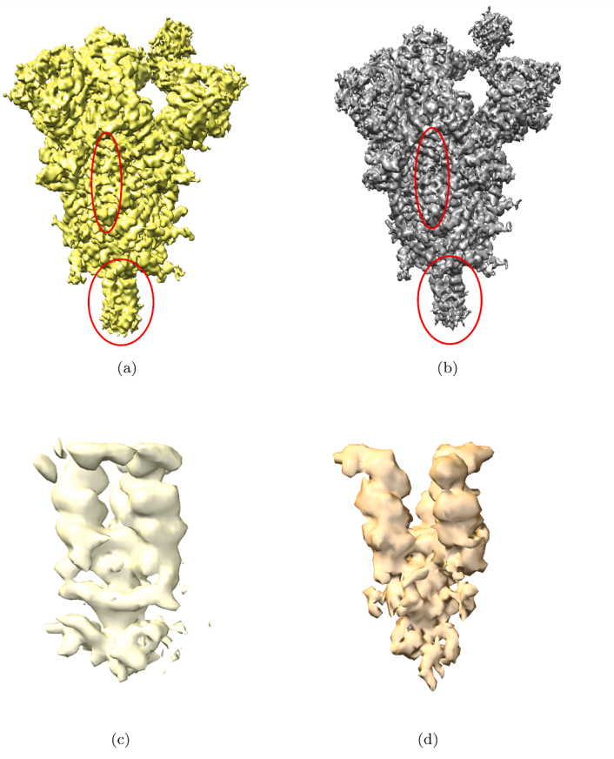
SARS-COV-2 Spike
CryoSparc
Deep Align
Deep Align
CryoSparc
Deep Align
Consensus
Z-axis
Y-axis

Slide 17
Conclusion
The first method that use deep learning in 3D alignment.
Compare with other methods, it has the best performance.
Consensus tool can be useful for improving the reconstructed 3D maps.
Managing 3D heterogeneity by deep learning approach in the future.

